Slide 1
DOM105
Session 8-9
Reading: SfM Ch. 9

Slide 2
What is a Hypothesis?
A Hypothesis is a Claim about a Population parameter such as population mean or proportion or std dev
Example: I hypothesize that the average IQ score of IBM employees is above 120.
Status Quo (H0): Average IQ is less than or equal to 120.
Alternative hypothesis (H1): IQ above 120.
If we said “Average IQ is above or equal to 120”, then that would be H0, with alt. hypothesis H1: “Average IQ less than 120”.
Please note the ‘equal to’ statement is always placed in H0, whereas the strict inequality is placed in H1.

Slide 3
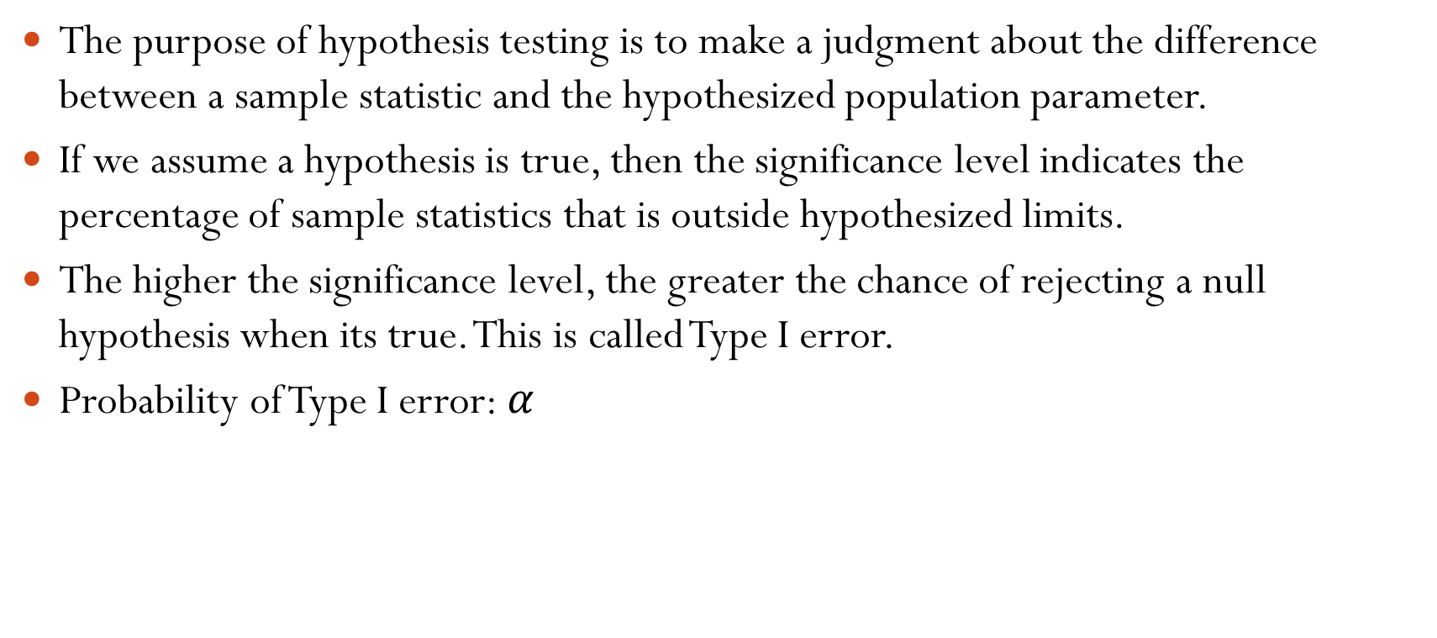
Significance level
The purpose of hypothesis testing is to make a judgment about the difference between a sample statistic and the hypothesized population parameter.
If we assume a hypothesis is true, then the significance level indicates the percentage of sample statistics that is outside hypothesized limits.
The higher the significance level, the greater the chance of rejecting a null hypothesis when its true. This is called Type I error.
Probability of Type I error: $α$

Slide 4
Hypothesis testing errors
Decision | H0: True | H0: False
Accept H0 | Correct decision | “Type II”error
Reject H0 | “Type I”error | Correct decision

Slide 5
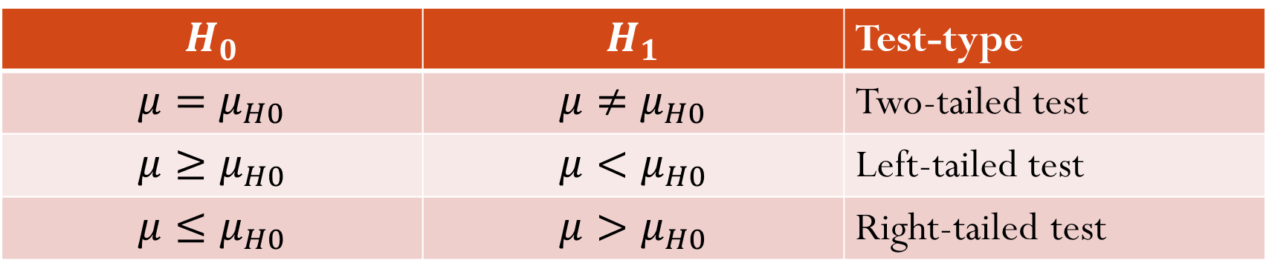
When to use one-tailed and two-tailed tests
Two-tails means there is a region on both sides of the null hypothesis where the hypothesis may be rejected.
One-tailed test is when a hypothesis is rejected only if the sample statistic is too low or too high.
The border values at which a null hypothesis is rejected is called the critical values
$$H_{0}$$ | $$H_{1}$$ | Test-type
$$μ=μ_{H0}$$ | $$μ≠μ_{H0}$$ | Two-tailed test
$$μ≥μ_{H0}$$ | $$μ<μ_{H0}$$ | Left-tailed test
$$μ≤μ_{H0}$$ | $$μ>μ_{H0}$$ | Right-tailed test

Slide 6
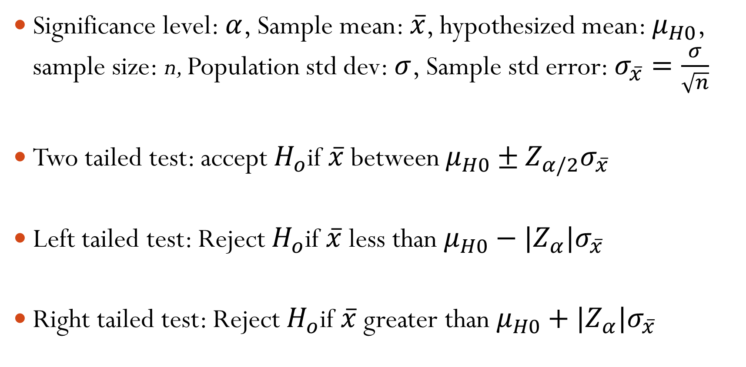
Hypothesis testing of mean when population std dev is known or n>100
Significance level: $α$, Sample mean: $\overline{x}$, hypothesized mean: $μ_{H0}$, sample size: n, Population std dev: $σ$, Sample std error: $σ_{\overline{x}}=\frac{σ}{\sqrt{n}}$
Two tailed test: accept $H_{o}$if $\overline{x}$ between $μ_{H0}±Z_{α/2}σ_{\overline{x}}$
Left tailed test: Reject $H_{o}$if $\overline{x}$ less than $μ_{H0}−|Z_{α}|σ_{\overline{x}}$
Right tailed test: Reject $H_{o}$if $\overline{x}$ greater than $μ_{H0}+|Z_{α}|σ_{\overline{x}}$

Slide 7
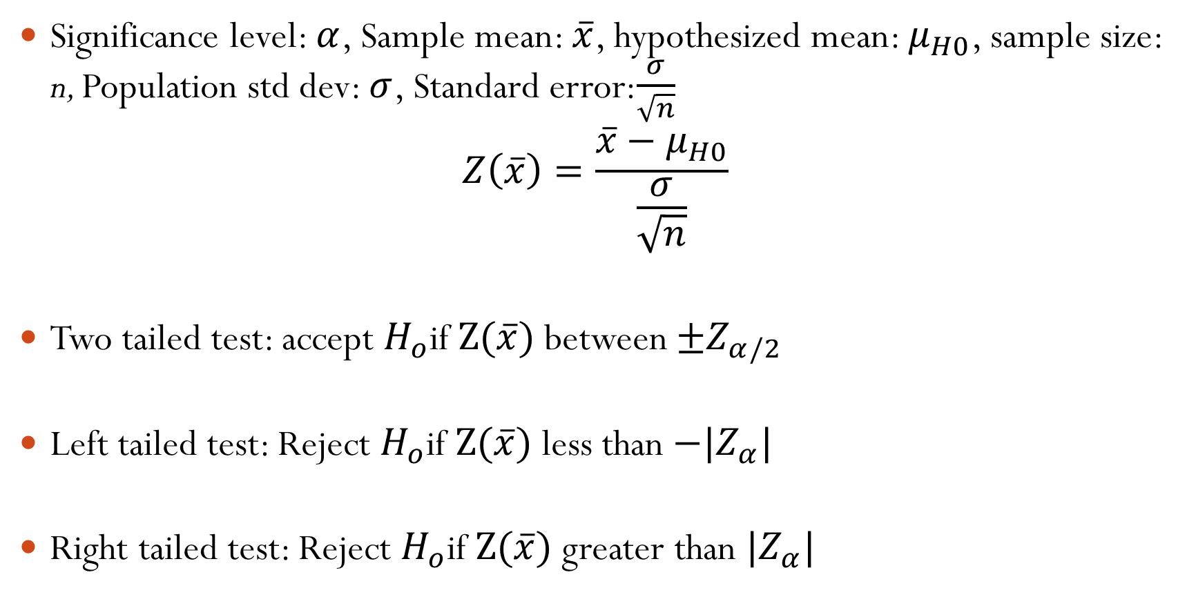
Hypothesis testing alternate method using Z score
Significance level: $α$, Sample mean: $\overline{x}$, hypothesized mean: $μ_{H0}$, sample size: n, Population std dev: $σ$, Standard error:$\frac{σ}{\sqrt{n}}$
$$Z\left(\overline{x}\right)=\frac{\overline{x}−μ_{H0}}{\frac{σ}{\sqrt{n}}}$$
Two tailed test: accept $H_{o}$if $Z(\overline{x})$ between $±Z_{α/2}$
Left tailed test: Reject $H_{o}$if $Z(\overline{x})$less than $−|Z_{α}|$
Right tailed test: Reject $H_{o}$if $Z(\overline{x})$greater than $|Z_{α}|$

Slide 8
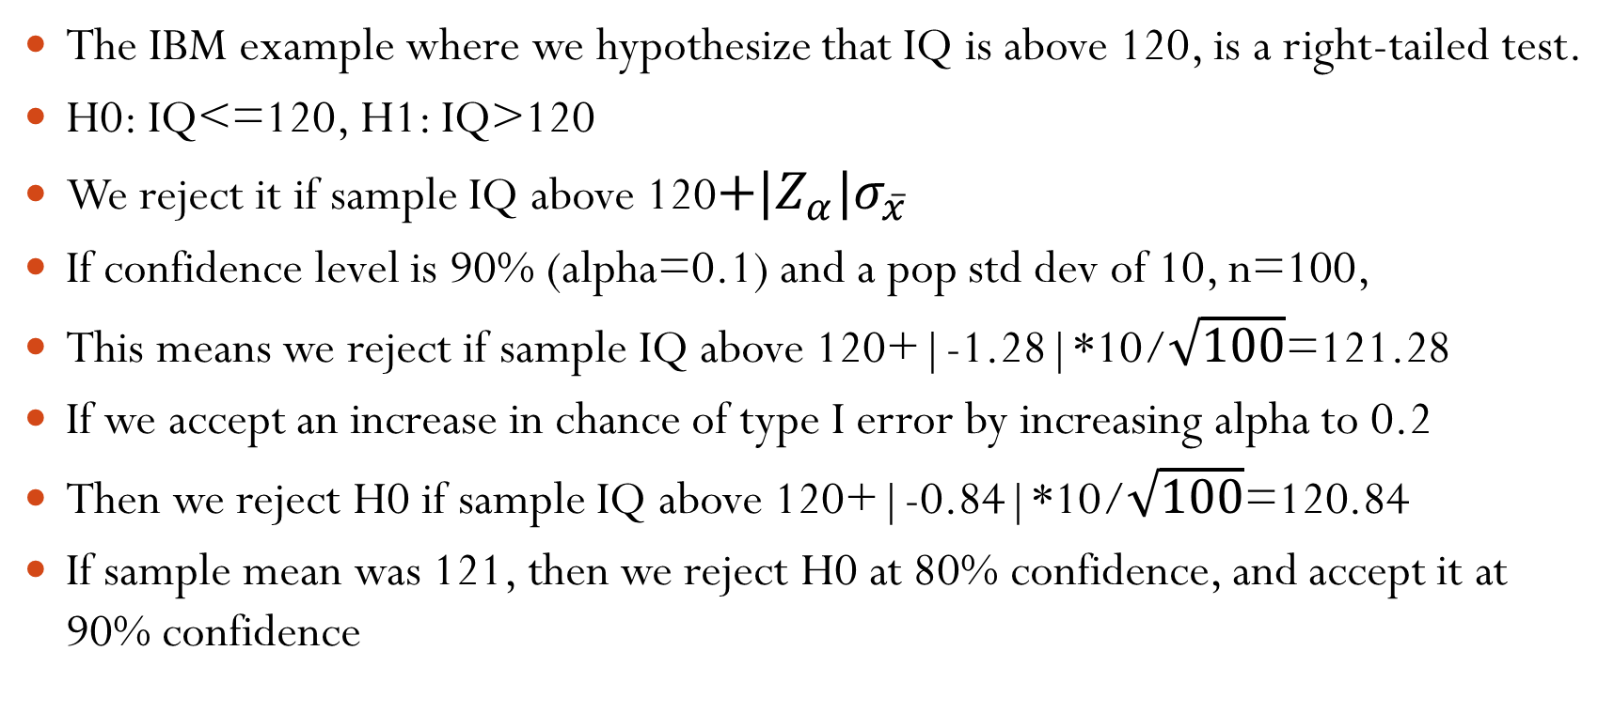
The IBM example where we hypothesize that IQ is above 120, is a right-tailed test.
H0: IQ<=120, H1: IQ>120
We reject it if sample IQ above 120$+|Z_{α}|σ_{\overline{x}}$
If confidence level is 90% (alpha=0.1) and a pop std dev of 10, n=100,
This means we reject if sample IQ above 120+|-1.28|*10/$\sqrt{100}$=121.28
If we accept an increase in chance of type I error by increasing alpha to 0.2
Then we reject H0 if sample IQ above 120+|-0.84|*10/$\sqrt{100}$=120.84
If sample mean was 121, then we reject H0 at 80% confidence, and accept it at 90% confidence

Slide 9
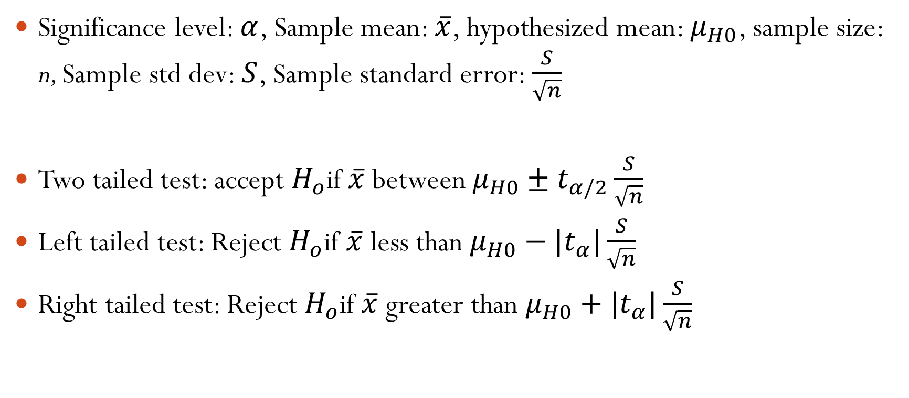
Hypothesis testing of mean when population std dev is unknown, n<100
Significance level: $α$, Sample mean: $\overline{x}$, hypothesized mean: $μ_{H0}$, sample size: n, Sample std dev: $S$, Sample standard error: $\frac{S}{\sqrt{n}}$
Two tailed test: accept $H_{o}$if $\overline{x}$ between $μ_{H0}±t_{α/2}\frac{S}{\sqrt{n}}$
Left tailed test: Reject $H_{o}$if $\overline{x}$ less than $μ_{H0}−|t_{α}|\frac{S}{\sqrt{n}}$
Right tailed test: Reject $H_{o}$if $\overline{x}$ greater than $μ_{H0}+|t_{α}|\frac{S}{\sqrt{n}}$

Slide 10
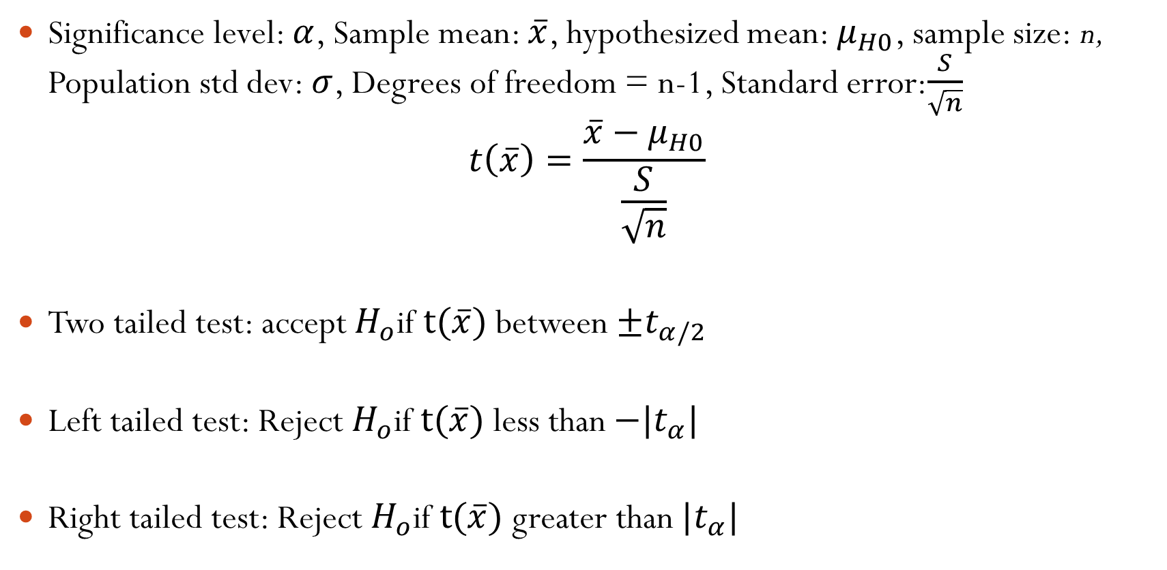
Hypothesis testing alternate method using t score
Significance level: $α$, Sample mean: $\overline{x}$, hypothesized mean: $μ_{H0}$, sample size: n, Population std dev: $σ$, Degrees of freedom = n-1, Standard error:$\frac{S}{\sqrt{n}}$
$$t\left(\overline{x}\right)=\frac{\overline{x}−μ_{H0}}{\frac{S}{\sqrt{n}}}$$
Two tailed test: accept $H_{o}$if $t(\overline{x})$ between $±t_{α/2}$
Left tailed test: Reject $H_{o}$if $t(\overline{x})$less than $−|t_{α}|$
Right tailed test: Reject $H_{o}$if $t(\overline{x})$greater than $|t_{α}|$

Slide 11
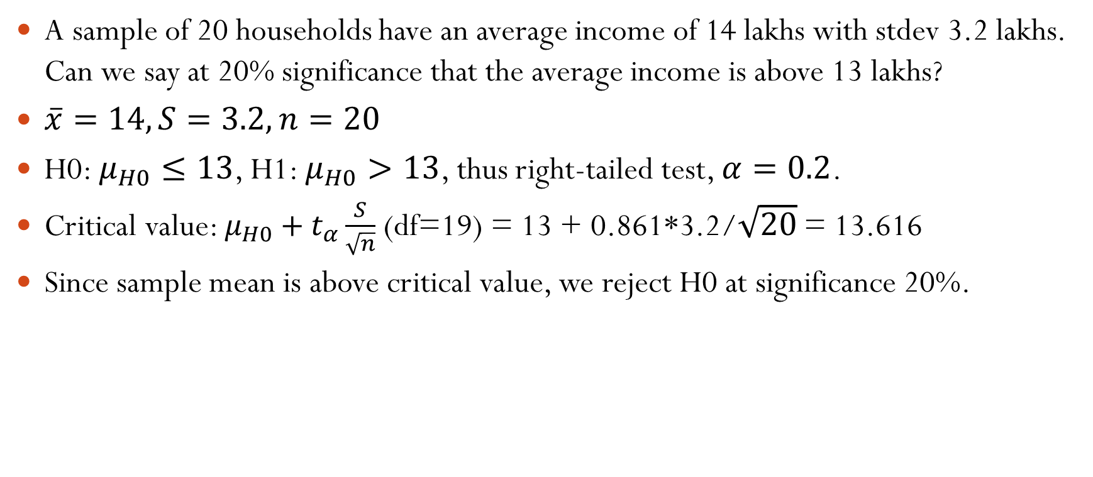
A sample of 20 households have an average income of 14 lakhs with stdev 3.2 lakhs. Can we say at 20% significance that the average income is above 13 lakhs?
$\overline{x}=14, S=3.2, n=20$
H0: $μ_{H0}≤13$, H1: $μ_{H0}>13$, thus right-tailed test, $α=0.2$.
Critical value: $μ_{H0}+t_{α}\frac{S}{\sqrt{n}}$ (df=19) = 13 + 0.861*3.2/$\sqrt{20}$ = 13.616
Since sample mean is above critical value, we reject H0 at significance 20%.

Slide 12
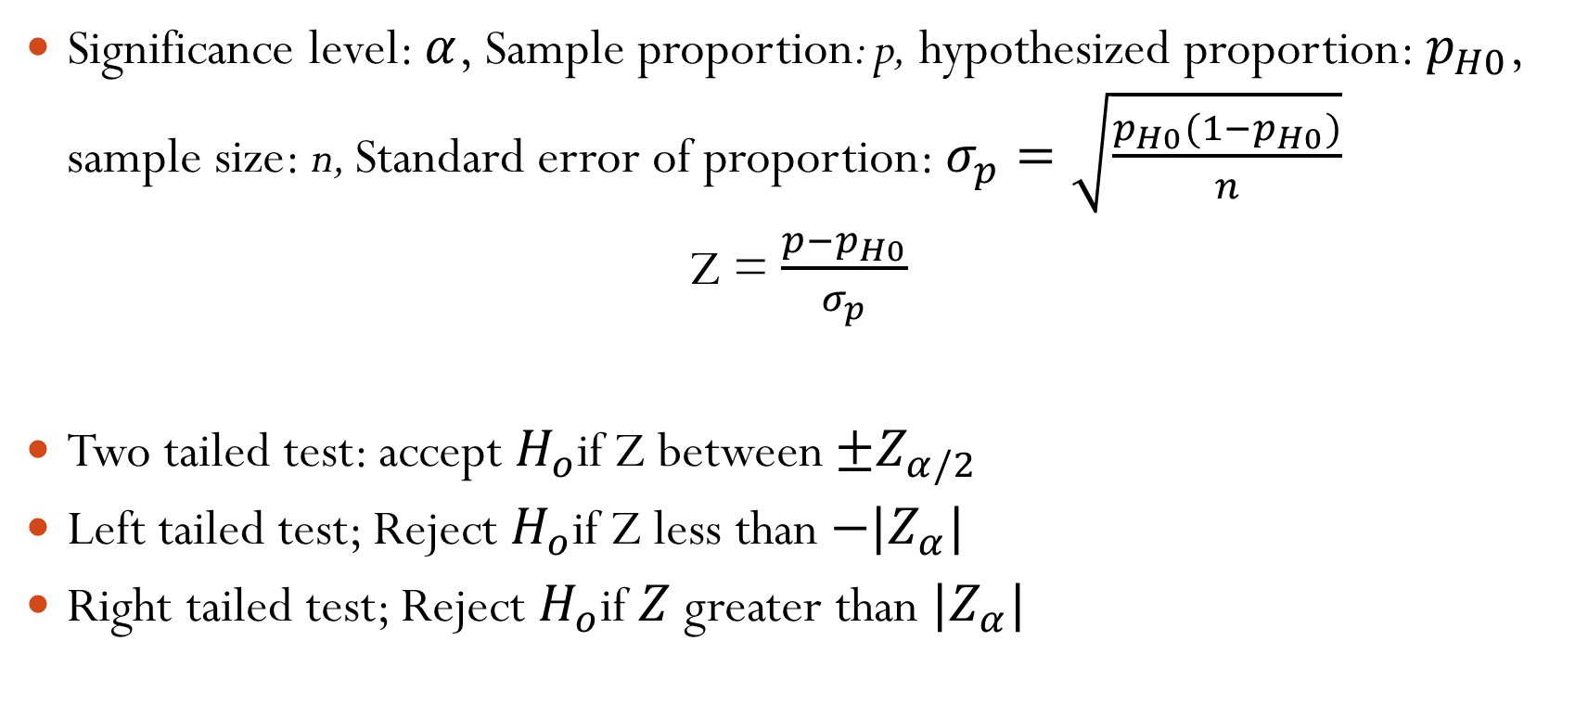
Hypothesis testing of proportion
Significance level: $α$, Sample proportion: p, hypothesized proportion: $p_{H0}$, sample size: n, Standard error of proportion: $σ_{p}=\sqrt{\frac{p_{H0}(1−p_{H0})}{n}}$
Z = $\frac{p−p_{H0}}{σ_{p}}$
Two tailed test: accept $H_{o}$if Z between $±Z_{α/2}$
Left tailed test; Reject $H_{o}$if Z less than $−|Z_{α}|$
Right tailed test; Reject $H_{o}$if $Z$ greater than $|Z_{α}|$

Slide 13
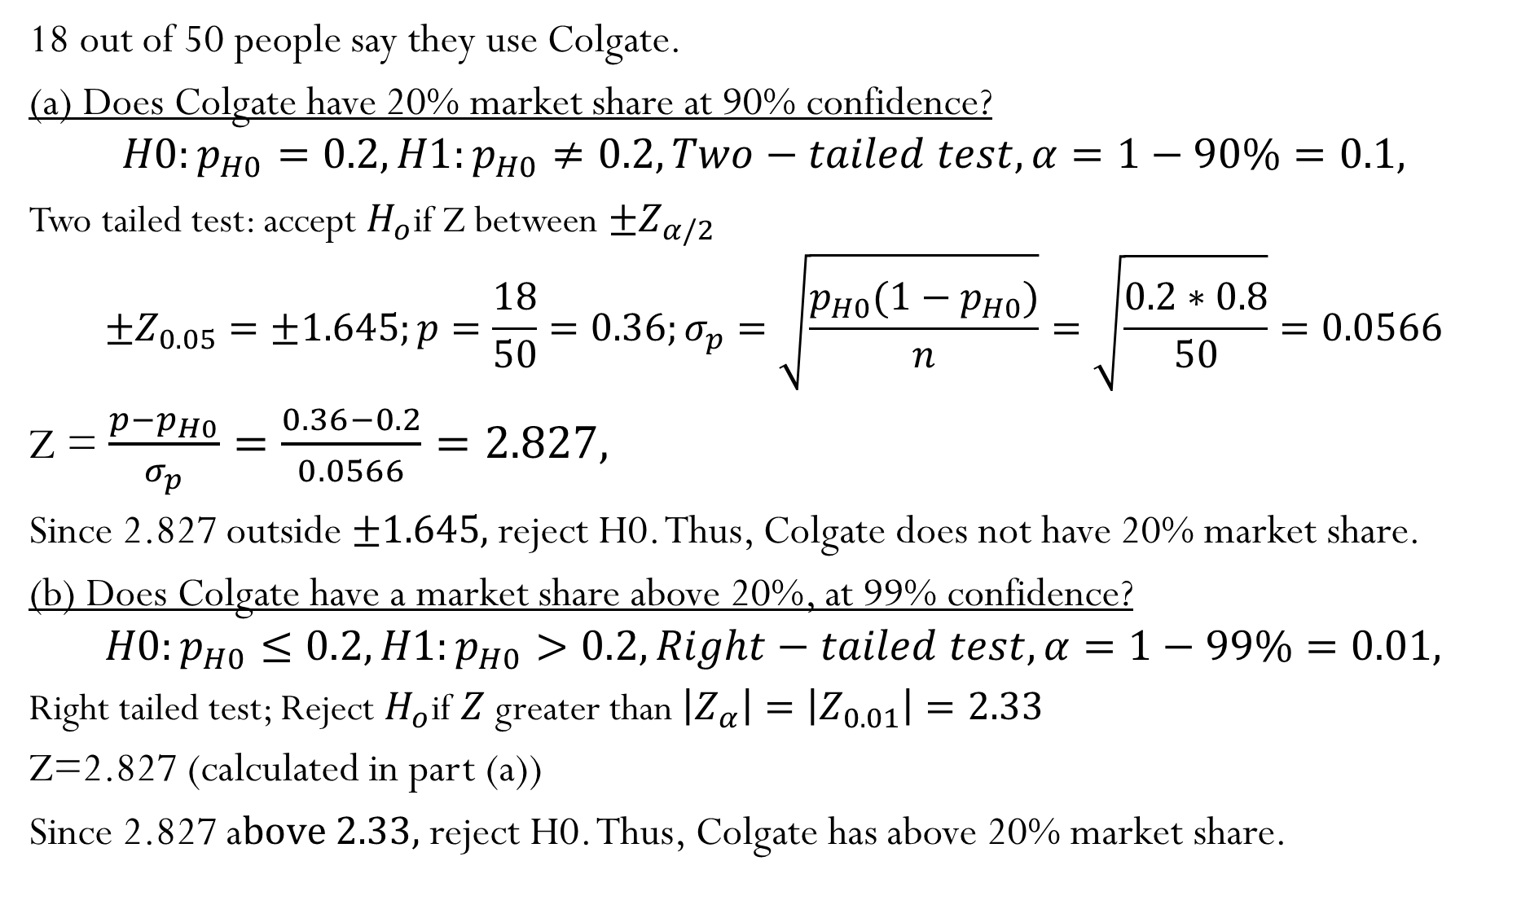
18 out of 50 people say they use Colgate.
(a) Does Colgate have 20% market share at 90% confidence?
$$H0:p_{H0}=0.2,H1:p_{H0}≠0.2, Two−tailed test, α=1−90\%=0.1,$$
Two tailed test: accept $H_{o}$if Z between $±Z_{α/2}$
$$±Z_{0.05}=±1.645;p=\frac{18}{50}=0.36;σ_{p}=\sqrt{\frac{p_{H0}(1−p_{H0})}{n}}=\sqrt{\frac{0.2∗0.8}{50}}=0.0566$$
Z = $\frac{p−p_{H0}}{σ_{p}}=\frac{0.36−0.2}{0.0566}=2.827,$
Since 2.827 outside $±1.645,$ reject H0. Thus, Colgate does not have 20% market share.
(b) Does Colgate have a market share above 20%, at 99% confidence?
$$H0:p_{H0}≤0.2,H1:p_{H0}>0.2, Right−tailed test, α=1−99\%=0.01,$$
Right tailed test; Reject $H_{o}$if $Z$ greater than $\left|Z_{α}\right|=\left|Z_{0.01}\right|=2.33$
Z=2.827 (calculated in part (a))
Since 2.827 a$bove 2.33,$ reject H0. Thus, Colgate has above 20% market share.

Slide 14
Steps in setting up a hypothesis test
State your hypothesis
Decide whether it is a two-tailed or one-tailed test (slide 5 table)
Decide significance level, depending on the cost of a Type I error vs Type II error (will be provided in problems)
Calculate the standard error of the sample statistic
Decide whether to use t-table or Z-table when determining the critical values and test statistic
Compare the value of the test statistic against the critical value(s) and interpret the result.

Slide 15
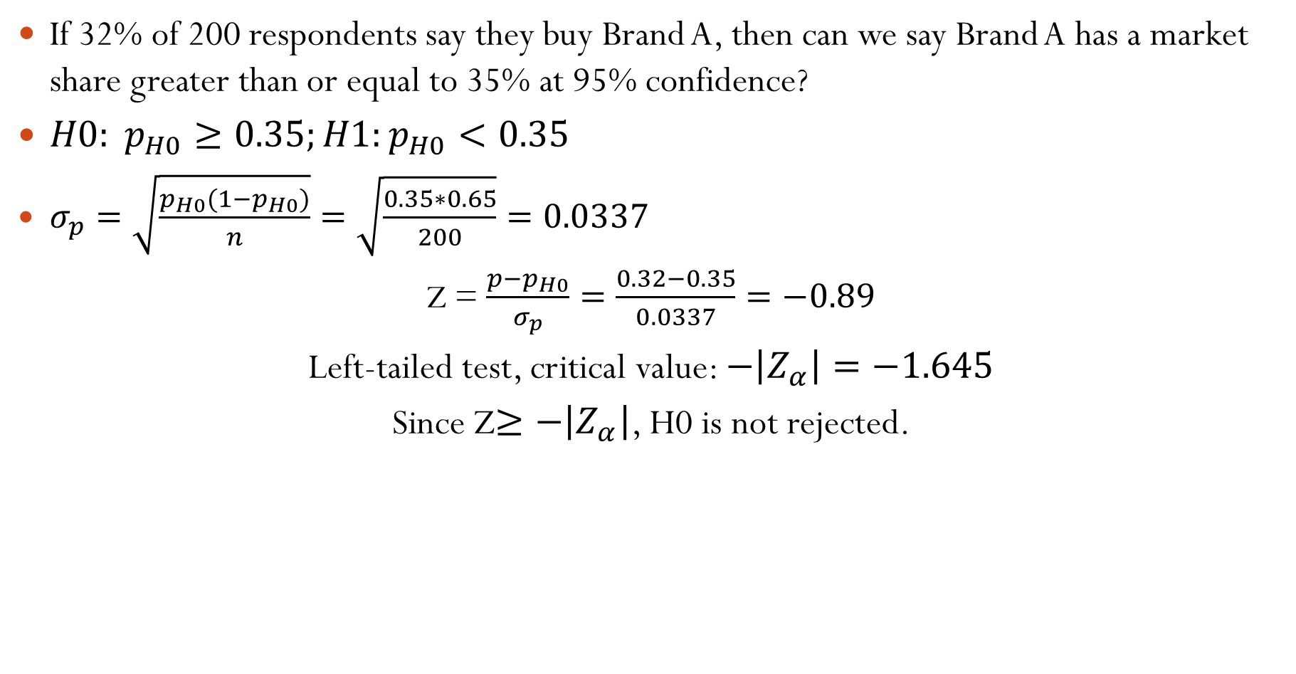
If 32% of 200 respondents say they buy Brand A, then can we say Brand A has a market share greater than or equal to 35% at 95% confidence?
$H0: p_{H0}≥0.35;H1:p_{H0}<0.35$
$σ_{p}=\sqrt{\frac{p_{H0}(1−p_{H0})}{n}}=\sqrt{\frac{0.35∗0.65}{200}}=0.0337$
Z = $\frac{p−p_{H0}}{σ_{p}}=\frac{0.32−0.35}{0.0337}=−0.89$
Left-tailed test, critical value: $−\left|Z_{α}\right|=−1.645$
Since Z$≥−\left|Z_{α}\right|$, H0 is not rejected.

